Slide 1

Forensic Vehicle Analysis
Sivaprasad
Rohit

Slide 2
Introduction
• Vehicle Detection: Implement algorithms to accurately detect vehicles within the video footage.
• License Plate Recognition: Develop functionality to recognize and extract license plate numbers from detected vehicles.
• Vehicle Attribute Recognition: Incorporate features to identify various attributes of the vehicles such as color.

Slide 3

objectives
• Save Time: Automating the process of detecting vehicles in video footage
saves cyber officials time compared to manually reviewing hours of footage.
• Gather Evidence: By extracting details like license plate numbers,
the project provides solid evidence for building cases against cybercriminals.
• Understand Behavior: Officials can analyze vehicle movements in footage
to understand patterns of suspicious activity or track routes taken.
• Integrate with Tools: The project can be integrated with existing cybersecurity tools,
making it easier for officials to use in their investigations.

Slide 4
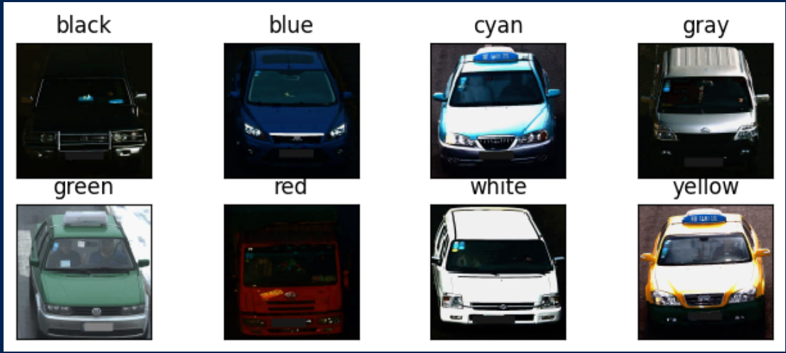
MODEL 1 :VEHICLE ATTRIBUTE DETECTION MODEL
Implemented a colour detection model from scratch
Training a model on a dataset of labeled colors

Slide 5
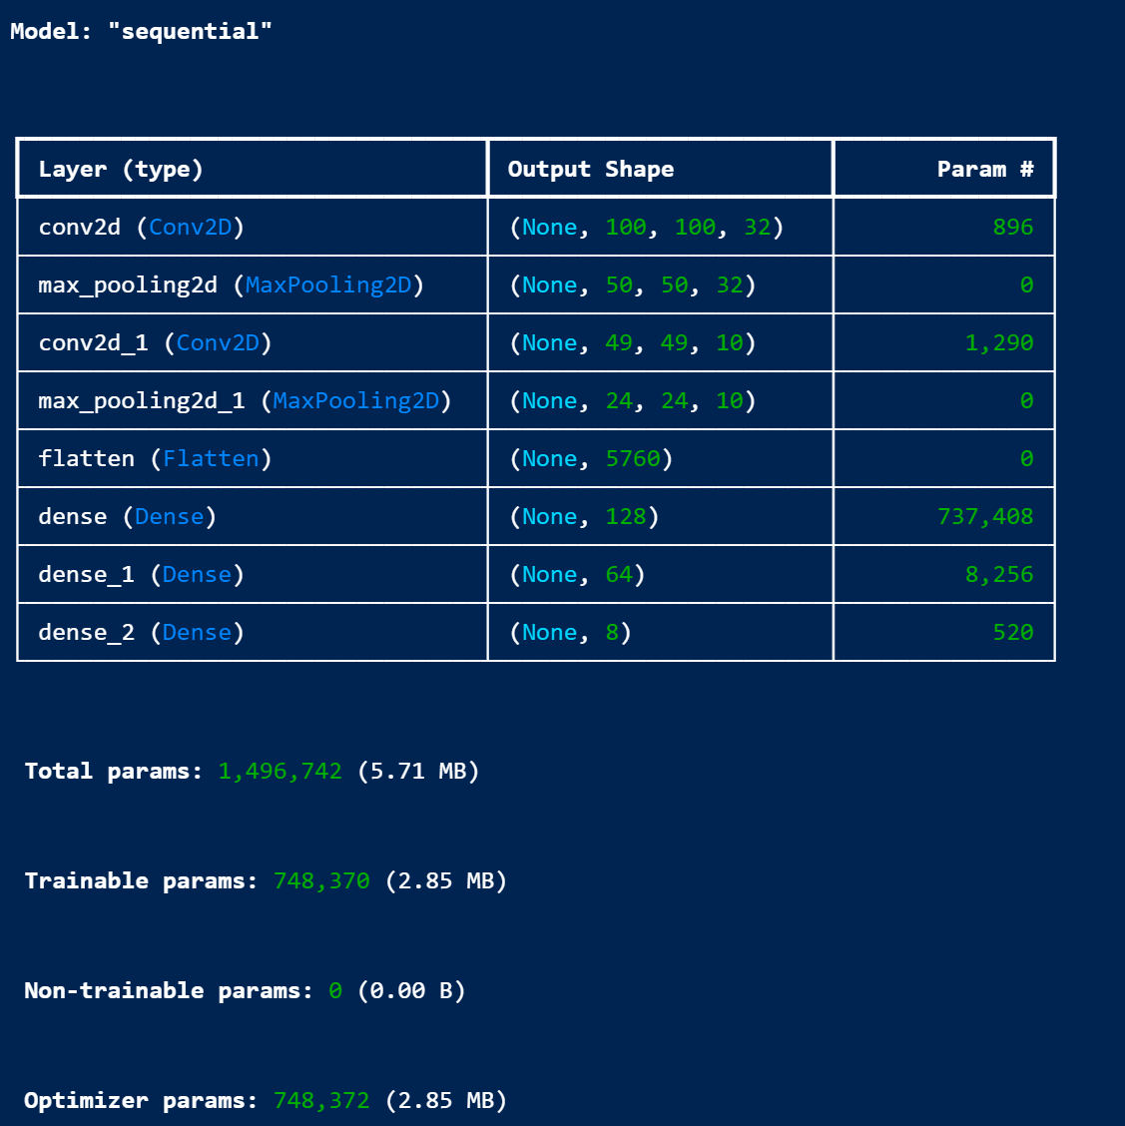
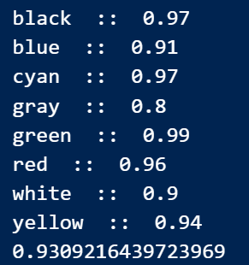
Model 1 : Network summary

Slide 6
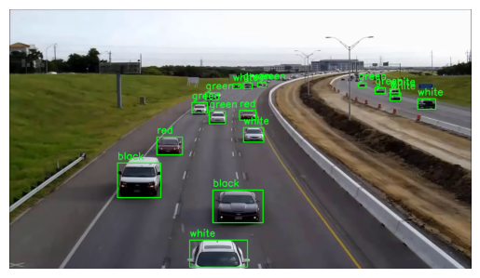
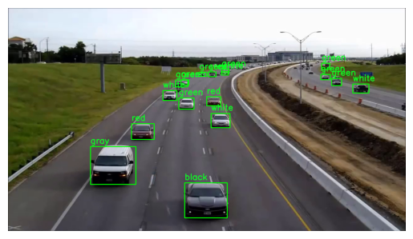
results

Slide 7
MODEL 2 : NUMBER PLATE RECOGNIZER
Utilized the COCO-trained YOLO v8 model to identify vehicles
Deployed an open source fine tuned YOLO model to specifically detect license plates.
Mapped each detected license plate to its corresponding vehicle by comparing the positions of their respective bounding boxes.
Extracted text from the detected license plate areas for each frame using EasyOCR (Optical Character Recognition).
Dataset : https://universe.roboflow.com/roboflow-universe-projects/license-plate-recognition-rxg4e/dataset/4

Slide 8
FINE TUNed YOLO
Freezing the base layer : Initial layers of the pre-trained model are frozen to retain their learned features. This prevents these layers from being updated during the fine-tuning process.
Added Custom Layer: New layers specific to the number plate detection task are added. These layers are trainable and are intended to adapt the pre-trained model to the new task.
The model is compiled with a suitable optimizer, loss function, and metrics

Slide 9
Why fine tuning ?
Specialized Accuracy: Fine-tuning a pre-trained YOLO model focuses on the specific task of number plate recognition, improving accuracy and reliability.
Efficient Resource Use: It leverages pre-trained features, reducing training time and computational resources compared to training from scratch.
Adaptation to Specific Data: Fine-tuning allows the model to adapt to the specific characteristics of number plates in the dataset, enhancing performance.
Maintains Real-Time Capabilities: Keeps YOLO’s strength in real-time detection while optimizing it for number plate recognition.

Slide 10
SORT(Simple Online and Realtime Tracking)
SORT is used for tracking objects across frames in a video sequence.
Kalman Filter: Used for predicting the future position of objects.
Hungarian Algorithm: Used for assigning detected objects to tracked objects in an optimal manner.
Bounding Box Association: Methods to associate detected bounding boxes with existing tracked objects.

Slide 11

USED FUNCTIONS
map_car(plate, tracking_ids): Maps detected number plates to their corresponding cars based on bounding box overlaps.
read_license_plate(image): Uses EasyOCR to read text from the cropped plate images.

Slide 12
Sample OUTPUT FROM MODEL
frame_nmb | car_id | car_bbox | plate_bbox | plate_bbox_score | license_nmb | license_nmb_score
0 | 1172.0 | [1097.907470703125, 578.7686767578125, 1393.89453125, 868.59423828125] | [1203.5208740234375, 776.0659790039062, 1288.745849609375, 819.3264770507812] | 0.5926178097724915 | WO51WSU | 0.03626770301959116

Slide 13
frame_nmb: Represents the frame number in a video sequence where the detection occurred. In this case, it is frame number 0.
car_id: An identifier assigned to each detected car. This can be useful for tracking cars across different frames. Here, the car ID is 1172.0.
car_bbox: The bounding box coordinates for the detected car in the format [x_min, y_min, x_max, y_max]. These coordinates define the rectangle that encloses the detected car.
plate_bbox: The bounding box coordinates for the detected number plate in the format [x_min, y_min, x_max, y_max]. These coordinates define the rectangle that encloses the detected number plate.
plate_bbox_score: The confidence score for the bounding box of the number plate. This score indicates the model's confidence in the detected bounding box being a number plate. A higher score means higher confidence. This score is calculated by the object detection algorithm.
license_nmb: The recognized text from the number plate. This is the actual license plate number extracted using OCR tool.
license_nmb_score: The confidence score for the recognized license plate number. This score indicates the OCR model's confidence in the extracted text being correct. This score is calculated by the OCR.

Slide 14
HOW WE CAN USE THE DATA
Store the extracted data from both models in a well-structured database for easy retrieval and analysis.
Use the combined data for cyber investigations, providing a solid evidence base to build cases and understand criminal activities.

Slide 15
CHALLENGES
Handling high-definition or lengthy video footage can be resource-intensive and may require optimization of the models and processing techniques.
Time constraints : Ensuring that the models process data in a timely manner to keep up with real-time investigation demands.

Slide 16
CONCLUSION
Automated Vehicle Detection: Implemented algorithms to accurately detect vehicles in video footage, significantly saving time for cyber officials.
License Plate Recognition: Developed a robust system for recognizing and extracting license plate numbers, providing solid evidence for investigations.
Vehicle Attribute Identification: Successfully incorporated features to identify vehicle attributes such as color, aiding in detailed vehicle profiling.

Slide 17

DEMO !!

